Slide 1
ButWhy , Imputing data, and the art of Interpretability
Medial EarlySign , AlgoTeam group

Slide 2
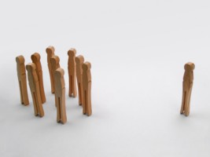
ButWhy vs. Importance
Feature Importance:
Group statistics : Which features/signals gave the most information on average
On the train population
ButWhy:
Individual : Which features were important for a specific patient

Slide 3
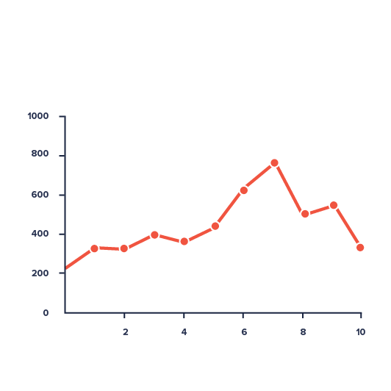
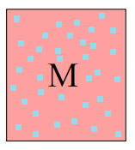

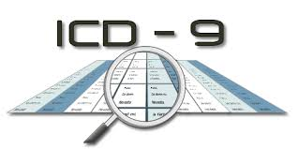
What happens in a model?
Data
Signals
Features
Matrix
Imputed Matrix
Classifier
Single
Signal
Features
Complex Features

Slide 4


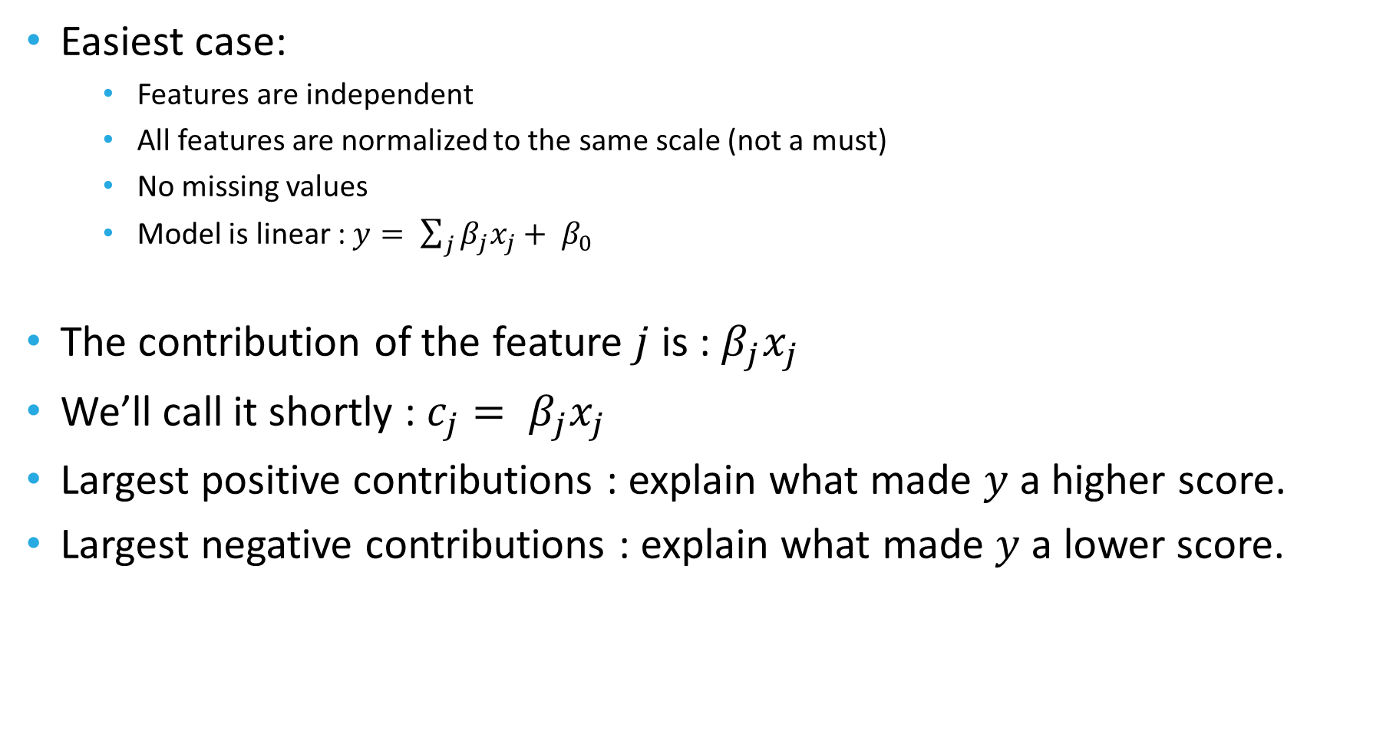
ButWhy - Get intuition using linear models
Easiest case:
Features are independent
All features are normalized to the same scale (not a must)
No missing values
Model is linear : $y= \sum_{j}{β_{j}x_{j}+ β_{0}}$
The contribution of the feature $j$ is : $β_{j}x_{j}$
We’ll call it shortly : $c_{j}= β_{j}x_{j}$
Largest positive contributions : explain what made $y$ a higher score.
Largest negative contributions : explain what made $y$ a lower score.

Slide 5
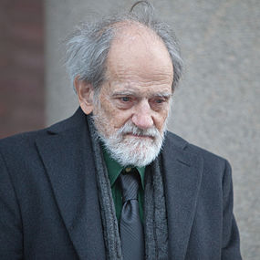
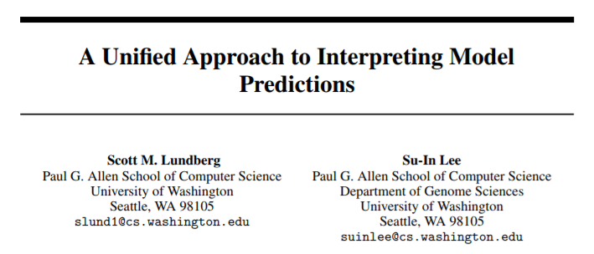
Non Linear models
Many methods and directions
Lately , united to some degree using Shapley values.
Lloyd Shapley : 1923 – 2016 , American
Nobel Prize in Economics 2012
One of the fathers of game theory

Slide 6

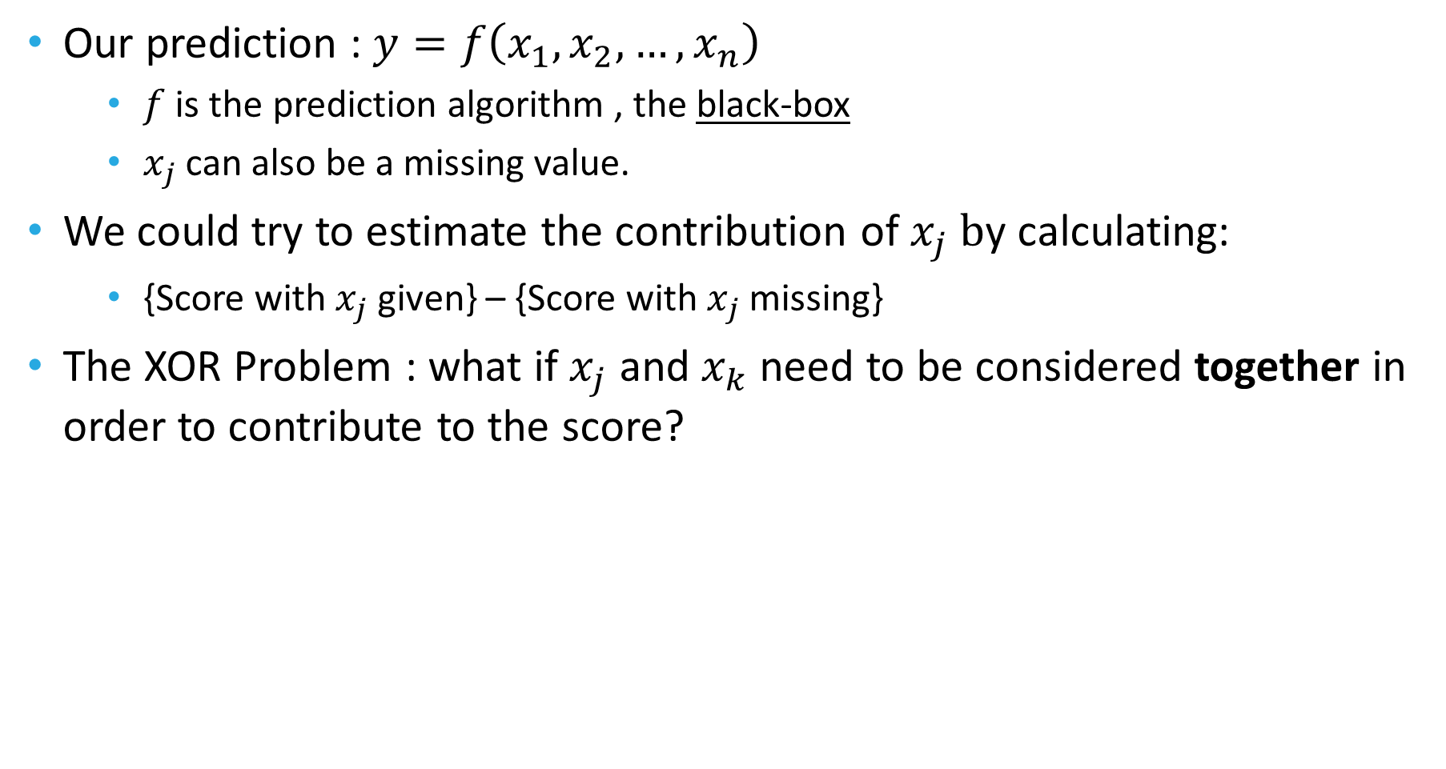
Intro to Shapley Values
Our prediction : $y=f\left(x_{1},x_{2},…, x_{n}\right)$
$f$ is the prediction algorithm , the black-box
$x_{j}$can also be a missing value.
We could try to estimate the contribution of $x_{j} b$y calculating:
{Score with $x_{j}$ given} – {Score with $x_{j}$missing}
The XOR Problem : what if $x_{j}$ and $x_{k}$ need to be considered together in order to contribute to the score?
 | 0 | 1
0 | 0 | 1
1 | 1 | 0
Knowing just $x_{j }$ or $x_{k} gives no information on y$

Slide 7
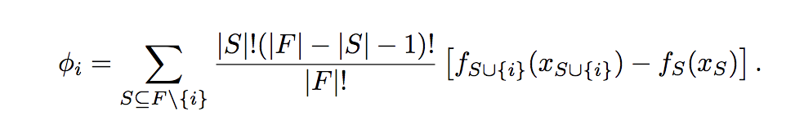
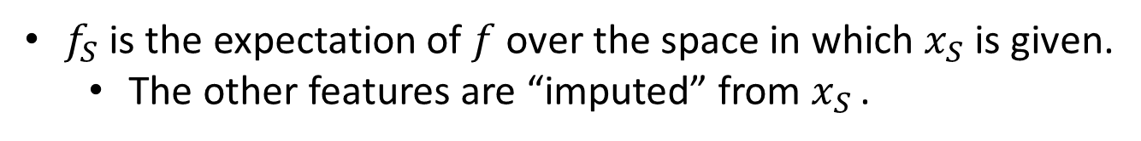
Deeper into Shapley
Due to complex connections between features (such as XOR) :
Go over all subgroups of features
For each subgroup calculate its contribution (score with it – score without it)
We still need a score for a single feature …
Enters the shapley theorem :
$f_{S}$ is the expectation of $f$ over the space in which $x_{S}$ is given.
The other features are “imputed” from $x_{S}$ .

Slide 8
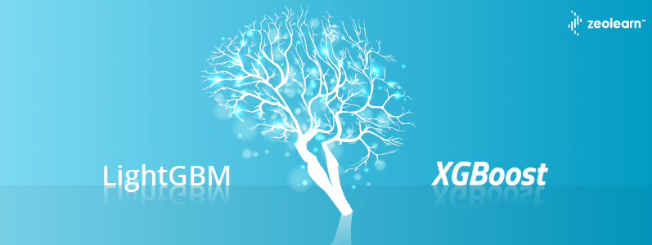
Problems with Shapley
The number of sub groups is exponential
No practical way to compute it on large feature sets
For some specific models, it is possible:
Linear models
Tree models (!)
Including: random forest, xgb, lightgbm.
For other cases: we can try to estimate the value by sampling only a small part of the subgroups
We need a fast way to calculate the score given only a subgroup of the features.

Slide 9
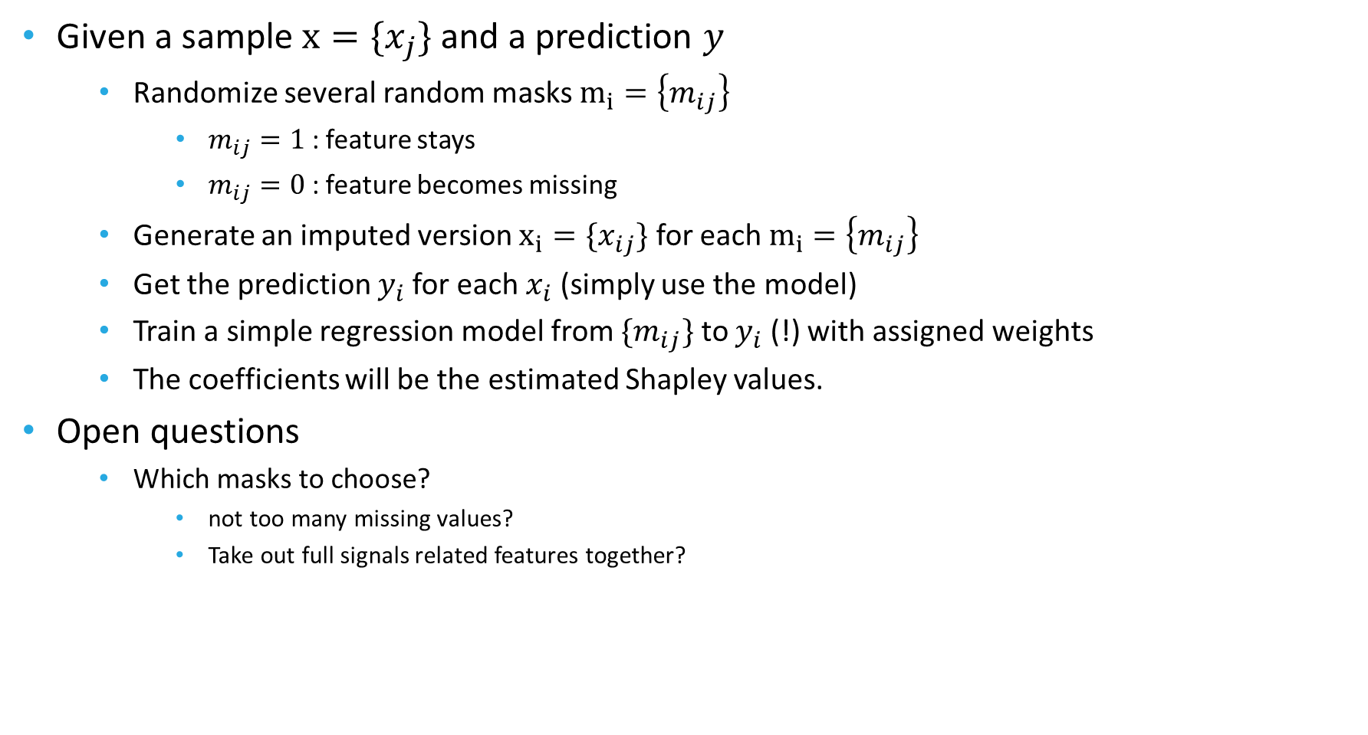
Shapley – Lime : agnostic to model
Given a sample $x=\{x_{j}\}$ and a prediction $y$
Randomize several random masks $m_{i}=\left\{m_{ij}\right\}$
$m_{ij}=1$ : feature stays
$m_{ij}=0$ : feature becomes missing
Generate an imputed version $x_{i}=\{x_{ij}\}$ for each $m_{i}=\left\{m_{ij}\right\}$
Get the prediction $y_{i}$for each $x_{i}$ (simply use the model)
Train a simple regression model from $\{m_{ij}\}$ to $y_{i}$ (!) with assigned weights
The coefficients will be the estimated Shapley values.
Open questions
Which masks to choose?
not too many missing values?
Take out full signals related features together?

Slide 10
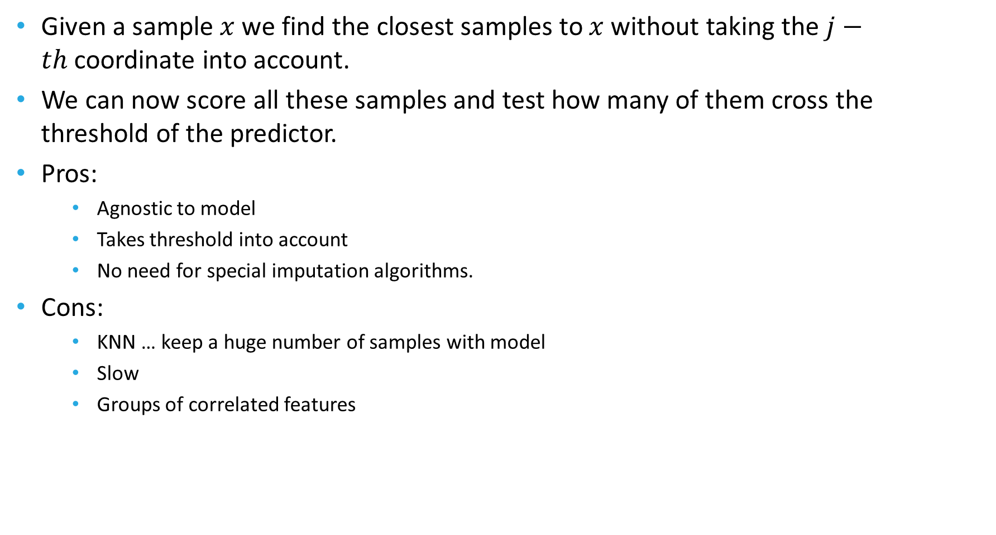
KNN based method
Given a sample $x$ we find the closest samples to $x$ without taking the $j−th$coordinate into account.
We can now score all these samples and test how many of them cross the threshold of the predictor.
Pros:
Agnostic to model
Takes threshold into account
No need for special imputation algorithms.
Cons:
KNN … keep a huge number of samples with model
Slow
Groups of correlated features

Slide 11
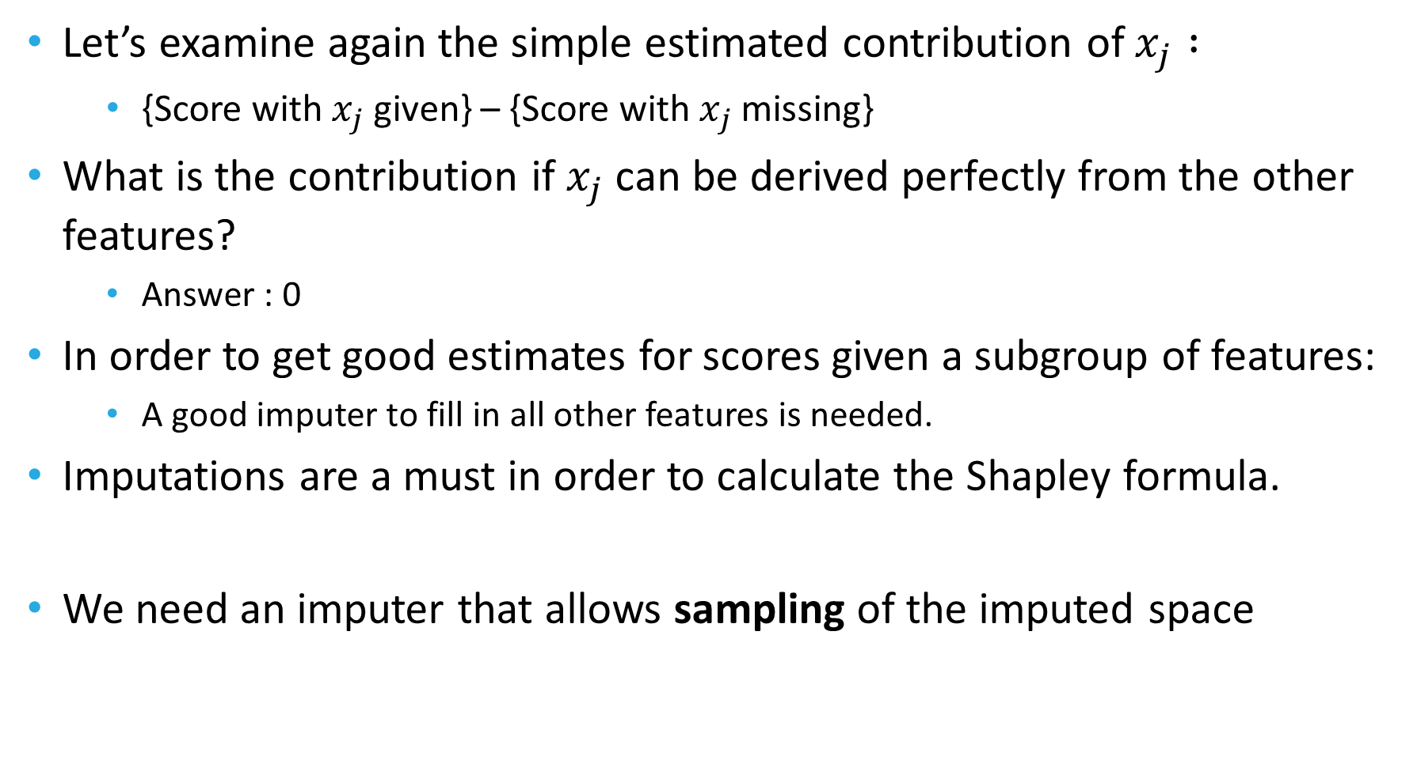
The connection between Imputing and ButWhy
Let’s examine again the simple estimated contribution of $x_{j} :$
{Score with $x_{j}$ given} – {Score with $x_{j}$missing}
What is the contribution if $x_{j}$ can be derived perfectly from the other features?
Answer : 0
In order to get good estimates for scores given a subgroup of features:
A good imputer to fill in all other features is needed.
Imputations are a must in order to calculate the Shapley formula.
We need an imputer that allows sampling of the imputed space

Slide 12
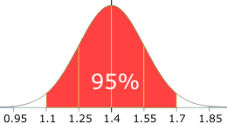
The other benefits of good imputing algorithms
Allow using algorithms that require full matrices
Linear models, logistic models
Neural Nets
Improve performance of predictions
Get confidence intervals for prediction over the space of missing data
And improve criteria for eligibility for scoring.
Missing Data
Imputed Data
Scores

Slide 13
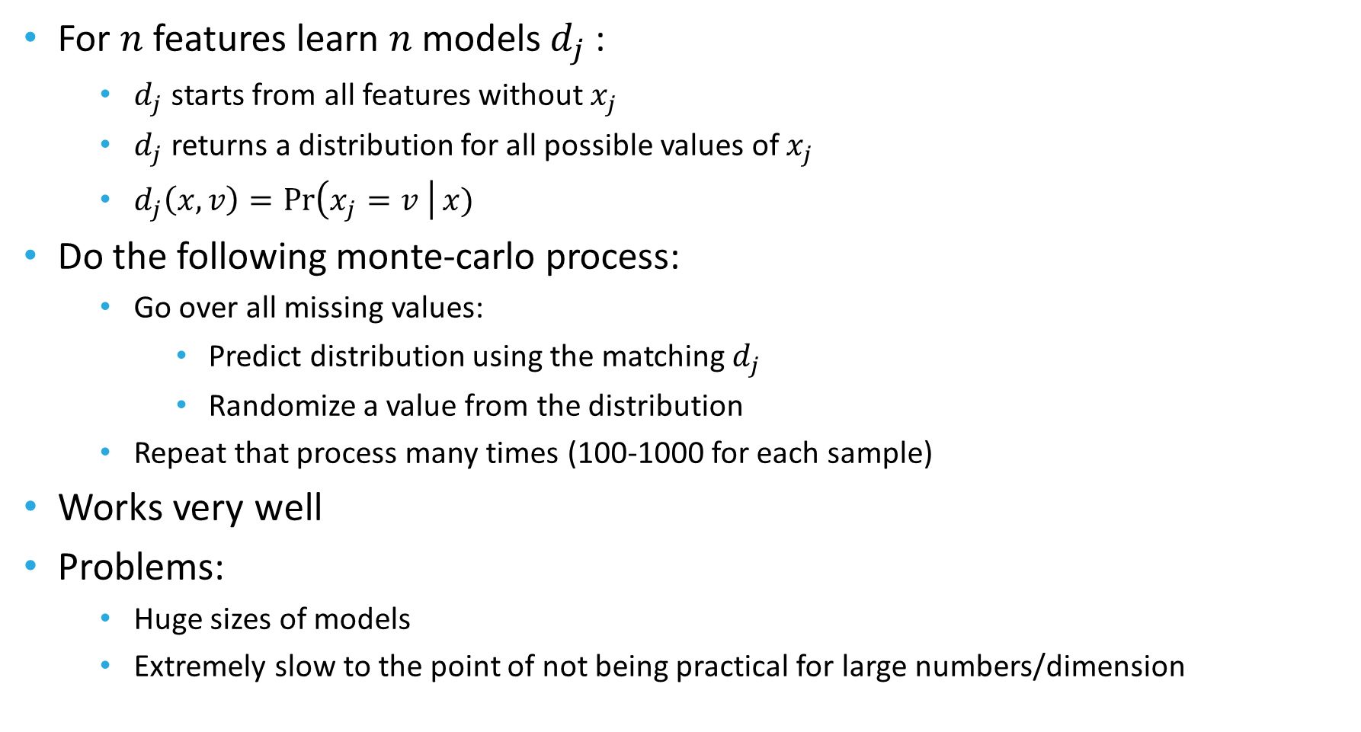
Better ways to impute – Gibbs Sampling
For $n$ features learn $n$ models $d_{j}$ :
$d_{j}$ starts from all features without $x_{j}$
$d_{j}$ returns a distribution for all possible values of $x_{j}$
$d_{j}\left(x, v\right)=\operatorname{Pr}\left(x_{j}=v \right|x)$
Do the following monte-carlo process:
Go over all missing values:
Predict distribution using the matching $d_{j}$
Randomize a value from the distribution
Repeat that process many times (100-1000 for each sample)
Works very well
Problems:
Huge sizes of models
Extremely slow to the point of not being practical for large numbers/dimension

Slide 14
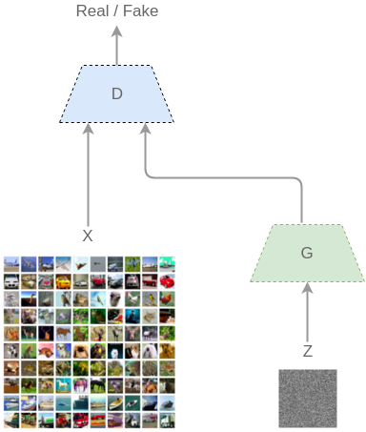
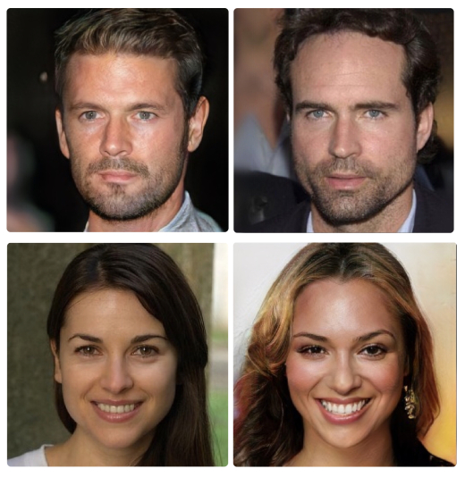
Better ways to impute - GANs
A recent method using deep learning :
Z : Random numbers
G : Generator model
D : Discriminator model
Generator learns to fake samples that can’t be separated from real ones
Discriminator learns to separate real and fake samples

Slide 15
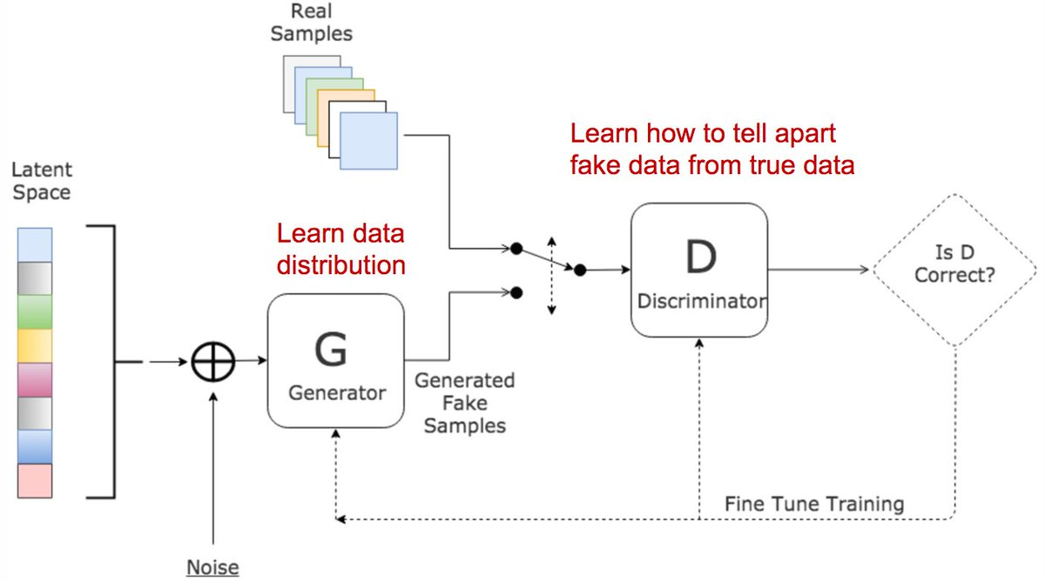
GANs for feature imputing
Real Samples
Full samples
Samples with missing data
Fake Samples
Known features plus mask of missing
Generator fills in missing data
If needed sample is then masked with a random real data missing mask
Big Advantage : Compact model, and fast in usage (!)

Slide 16
Imputing methods comparison
Simple : Using mean/median given age and gender
Gibbs
GAN
Trying to separate a real population of full samples from imputed samples: (lower is better !)
Method | Separation AUC
Simple | 0.97
Gibbs | 0.52
GAN | 0.61

Slide 17
Current state
Each model can train an explainer as part of the infrastructure
An explainer returns :
A list of the top features contributing most to score
A list of the top signals contributing most to score
The explanations are returned as attributes in the predictions file.
Options to use Shapley on linear and tree models directly.
Options to use Shapley-Lime estimations using subgroup sampling and imputing algorithms.
New interesting methods to impute data implemented.

Slide 18
ToDo – ButWhy and Imputations
Handle feature correlation problem
Not described in this lecture , but a big issue.
Heuristics using correlation matrix
Better handle signals (group of features) contribution
Finish implementation and test on real models
Design and implement AM API for ButWhy
Finish GAN direction work
Test new imputation mechanisms:
In Shapley-Lime method
Performance wise
Generate score distribution over missing values space

Slide 19
What’s happening in the AlgoTeam
Pre2D Paper | CKD | CVD | Flu MHS , KP GHS
Lung Ca. | AAA | Ddimer | ButWhy
GAN | What If BP | Dockers | Embeddings
RNNs | NBA | Hematuria | Linux AM

